Slide 1
Introduction to Bayesian Inference for Parameter Estimation
OR, how bayesian inference is much, much better than hypothesis tests for real world decisions

Slide 2
Outline
What is Bayesian Inference anyway?
Motivated via a simple coin-toss experiment + demo
The German Tank Problem
(If we have the time) Linear Regression: Curve fitting vs parameter estimation
When you should use Bayesian Estimates vs classical hypothesis tests

Slide 3
$ whoami

Slide 4
Is the coin fair?

Slide 5
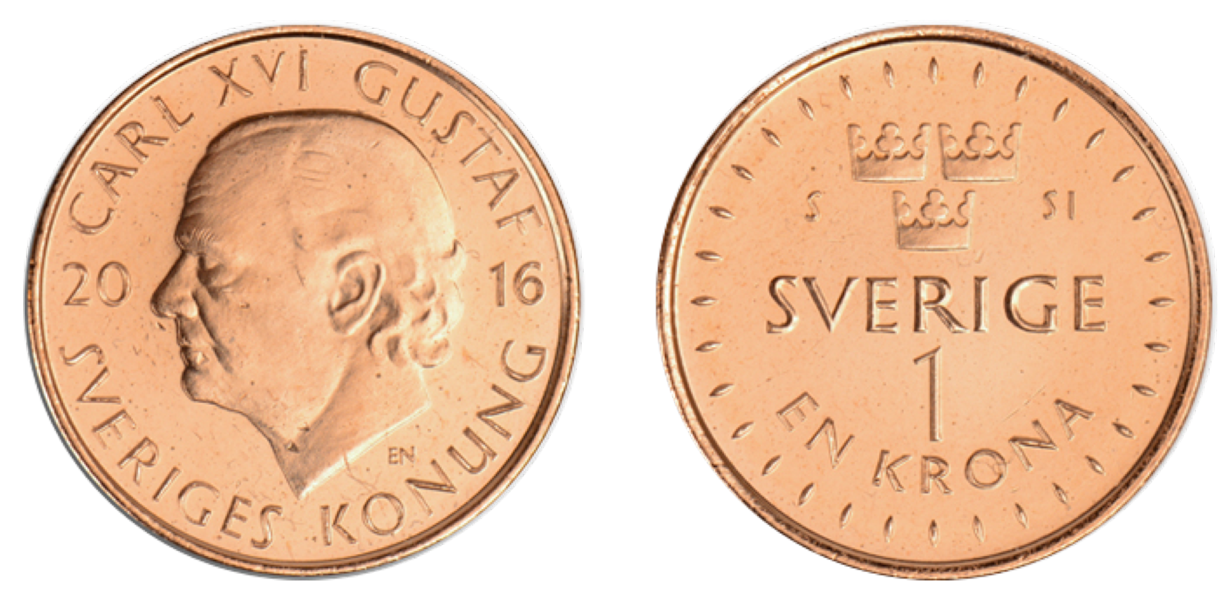
Is this coin fair?
I give you a coin
Can you guess whether the coin is fair?

Slide 6
Is this coin fair?
Well, what does fair mean?

Slide 7
Let’s reframe the problem

Slide 8
Is this coin fair?
Given a coin, can you estimate the probability of getting a Heads on the coin?
If all outcomes (Heads, Tails) are equally likely (within some tolerance), then we can say that the coin is fair.

Slide 9
Is this coin loaded?
If I hand you the coin, how would you find out the probability of heads?

Slide 10
Is this coin loaded?
Maybe you do this:
Flip the coin many time
P(H) = Number of Heads/Number of coin tosses

Slide 11
Is this coin loaded?
This is called estimation

Slide 12
Is this coin loaded?
If you’re familiar with point estimates and Binomial Distribution, you’ll know that we just got calculated MLE for the Binomial Likelihood.

Slide 13
Is this coin loaded?
Let’s say we flip a coin a many times
Notes:
(At this point, run a Jupyter experiment for this - estimating the parameter. Then, plot the distribution)
(Ask whether all estimates are equally likely? No? Why?)
(Big takeaway - there is a distribution of possible values of P(H))

Slide 14
Is this coin loaded?
But, what if I only let you flip the coin 5 times.

Slide 15
5 coin flips:
Heads: 4
Tails: 1
Is P(H) == 4/5 == 80%?
Notes:
Why not?
How does experience tell you to discount evidence?

Slide 16
Probability and belief
Some probabilities make intuitive sense
50% probability to throw heads on a coin
About 2.78% probability of throwing snake eyes at craps
About 4.7% probability to draw two pairs at poker
While others are not as easy to understand within the ‘flip-a-coin-many-times’ framework
Probability of snow tomorrow
Probability that a candidate will win an election
Probability that the sun will rise tomorrow

Slide 17
Probability and belief
What is experience? What really is intuition? How do we inject experience into decision-making?

Slide 18
The Bayesian (Subjectivist) interpretation
Probability is a measure of a belief
p=0 means “I’m certain that the event is false”
p=1 means “I’m certain that the event is true”
p=0.5 means “Neither true nor false is more likely”
Different observers can assign different probabilities to the same event (subjective probability).
Bayesian: someone who adheres to this interpretation of probability.

Slide 19
Some notation
Event - a statement that can be true or false
“It will snow tomorrow”, “I roll 6 on this die”
Probability - the subjective measure of belief in the event
P(“It will snow tomorrow”) = 2% P(“This slide is green”) = 0% P(“I’m giving this talk from Berlin”) = 100%
Conditioning - the act of assuming that an event is true
P(“it has two wheels” | “it’s a bicycle”) = 95% (?)

Slide 20
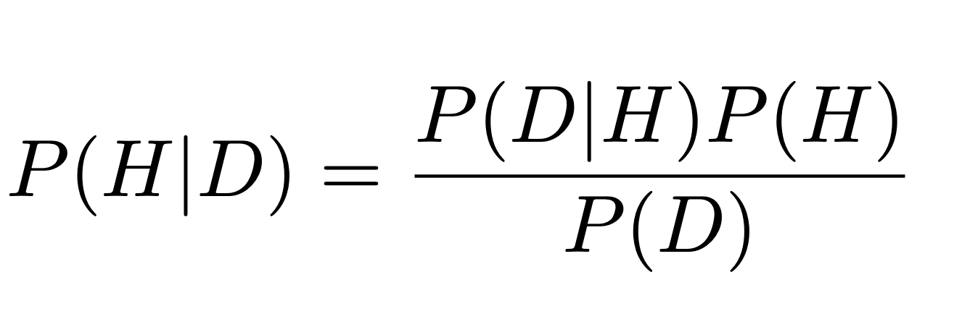
Bayes’ theorem
H - our hypothesis about a state of a “something”
D - data collected from observations of the “something”
Bayes’ theorem:

Slide 21
Common Bayesian Jargon
P(H) - Prior P(D | H) - Likelihood P(D) - Predictive probability, marginal Likelihood, evidence P(H | D) - Posterior

Slide 22
Modeling belief and incorporating evidence
We have some belief about events
We see some evidence of those events happening
We ‘modulate’ our belief based on experience

Slide 23
Modeling a coin toss with maths
Notes:
(Why not use Uniform?)
(Why use Beta prior - show some beta prior plots)
(On Jamboard/some pen-and-paper)
(Explain that denominator is just a normalization constant - we don’t need to calculate it)
(Cookbook of priors as Appendix)

Slide 24
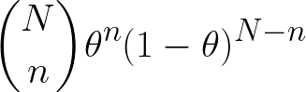
Modeling the coin flips
P(n|Θ) - Probability of throwing n HEADS in N throws if the head probability is Θ

Slide 25
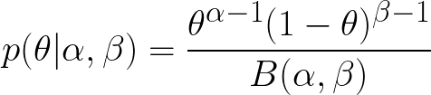
Beta Prior
Allows us to represent beliefs about variables between 0 and 1

Slide 26
Computing the posterior using Bayes’ theorem

Slide 27
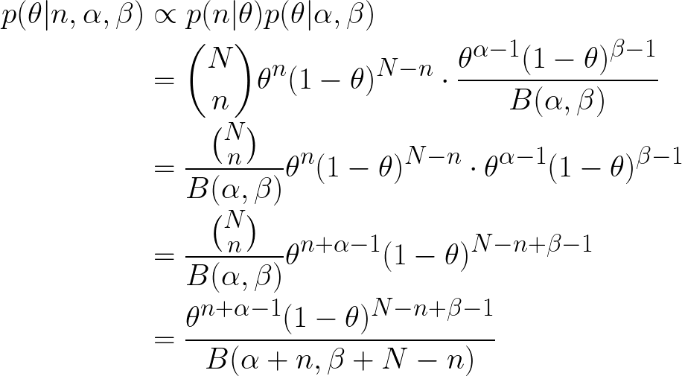
Calculating posterior distribution of the success parameter

Slide 28
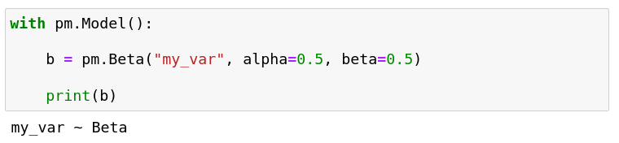
PyMC: models
PyMC allows us to define probabilistic models in python
Models are defined using the pm.Model() context manager
Very similar to the maths!

Slide 29
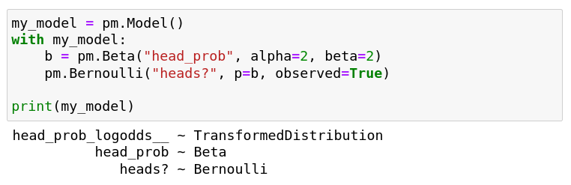
PyMC: conditioning
Variables in the model can be observed, this is equivalent to conditioning!

Slide 30
PyMC: Inference
Once we have defined the model, we can manipulate it
Maximum a posteriori estimation
Posterior sampling
Posterior analysis (traces, histograms, densities)
Read more: getting started with PyMC3

Slide 31
Coin Toss - PyMC vs hand-calculated posterior

Slide 32
German Tank Problem

Slide 33
Linear Regression - Estimate params as distributions
Notes:
Curve fitting vs parameter estimation
First do via simple sklearn regressor - show one line
Possible values of slope + intercept
Make a PyMC model + explain
Show ribbon over 95% HDI
Overlay/Side by side with sklearn model
How is putting priors equivalent to ridge/lasso regression/in general regularization
Also try out with various priors

